Slide 1
MCDA 5520 Statistics & Business Analytics
Review of Basic Stats Concepts
Michael Zhang

Slide 2
Statistics vs Econometrics
Statistics – the science of collecting, organizing, analyzing, interpreting, and presenting data for the purpose of gaining insight and making better decisions.
Descriptive Stats – collection, organization, and description
Inferential Stats – making estimates, decisions, predictions or other generalizations
Econometrics – Application of Statistics to economic data.

Slide 3
Descriptive Statistics
Collect data
e.g. Survey, Observation, Experiments
Present data
e.g. Charts and graphs
Characterize data
e.g. Sample mean =

Slide 4
Populations and Samples
Population – all items of interest for a particular decision or investigation
All married drivers in the Canada over age 25
All individuals who do not own a cell phone
Sample – a subset of a population
Nielsen samples of TV viewers
Accounting department samples of invoices for audits
Why Samples?
Less time consuming than a census
Less costly to administer than a census
It is possible to obtain statistical results of a sufficiently high precision based on samples

Slide 5
Sampling Techniques
Samples
Non-Probability Samples
Probability Samples
Simple
Random
Systematic
Judgement
Convenience
Cluster
Stratified

Slide 6
Probability (Statistical) Sampling
Items of the sample are chosen based on known or calculable probabilities
Probability Samples
Simple
Random
Stratified
Systematic
Cluster

Slide 7
Simple Random Samples
Every individual or item from the population has an equal chance of being selected
Selection may be with replacement or without replacement
Samples can be obtained from a table of random numbers or computer random number generators

Slide 8
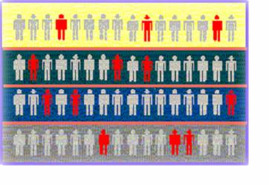

Stratified Samples
Population divided into subgroups (called strata) according to some common characteristic
Simple random sample selected from each subgroup
Samples from subgroups are combined into one
Population
Divided
into 4
strata
Sample

Slide 9
Key Definitions
A population is the entire collection of things under consideration
A parameter is a summary measure computed to describe a characteristic of the population
A sample is a portion of the population selected for analysis
A statistic is a summary measure computed to describe a characteristic of the sample

Slide 10
Inferential Statistics
Making statements about a population by examining sample results
Sample statistics Population parameters
(known) Inference (unknown, but can
be estimated from
sample evidence)

Slide 11
Inferential Statistics
Drawing conclusions and/or making decisions concerning a population based on sample results.
Estimation
e.g.: Estimate the population mean weight using the sample mean weight
Hypothesis Testing
e.g.: Use sample evidence to test the claim that the population mean weight is 120 pounds

Slide 12
Data Measurement Levels
Highest Level
Complete Analysis
Measurements
Ratio/Interval Data
Rankings
Ordered Categories
Higher Level
Mid-level Analysis
Ordinal Data
Categorical Codes ID Numbers Category Names
Lowest Level
Basic Analysis
Nominal Data

Slide 13
Terminology and Notation
Parameter – a measurable characteristic of a population: μ is a parameter, is not
x_{i} represents the i^{th} observation
∑ indicates the operation of addition
N is the size of the population; n is the size of the sample
f_{i} is the number of observations in cell i of a frequency distribution

Slide 14
Descriptive Statistics
Frequency distributions and histograms
Measures of central tendency
Measures of dispersion

Slide 15
Frequency Distributions
A frequency distribution is a list or a table.
containing the values of a variable (or a set of ranges within which the data falls).
and the corresponding frequencies with which each value occurs (or frequencies with which data falls within each range).

Slide 16
Why Use Frequency Distributions?
A frequency distribution is a way to summarize data.
The distribution condenses the raw data into a more useful form.
and allows for a quick visual interpretation of the data.

Slide 17
Histograms
The classes or intervals are shown on the horizontal axis
frequency is measured on the vertical axis
Bars of the appropriate heights can be used to represent the number of observations within each class
Such a graph is called a histogram

Slide 18
Histograms

Slide 19
Types of Relationships
Linear Relationships

Slide 20
Types of Relationships
Curvilinear Relationships

Slide 21
Types of Relationships
No Relationship

Slide 22
Summary Measures
Describing Data Numerically
Center and Location
Other Measures of Location
Variation
Mean
Range
Percentiles
Median
Interquartile Range
Quartiles
Mode
Variance
Weighted Mean
Standard Deviation
Coefficient of Variation

Slide 23
Measures of Center and Location
Center and Location
Mean
Median
Mode
Weighted Mean

Slide 24
Mean
The Mean is the arithmetic average of data values
Sample mean
Population mean
n = Sample Size
N = Population Size

Slide 25
Mean
The most common measure of central tendency
Mean = sum of values divided by the number of values
Affected by extreme values (outliers)
0 1 2 3 4 5 6 7 8 9 10
0 1 2 3 4 5 6 7 8 9 10
Mean = 3
Mean = 4

Slide 26
Median
Not affected by extreme values
In an ordered array, the median is the “middle” number
If n or N is odd, the median is the middle number
If n or N is even, the median is the average of the two middle numbers
0 1 2 3 4 5 6 7 8 9 10
0 1 2 3 4 5 6 7 8 9 10
Median = 3
Median = 3

Slide 27
Mode
A measure of central tendency
Value that occurs most often
Not affected by extreme values
Used for either numerical or categorical data
There may be no mode
There may be several modes
0 1 2 3 4 5 6 7 8 9 10 11 12 13 14
0 1 2 3 4 5 6
Mode = 5
No Mode

Slide 28
Review Example
Five houses on a hill by the beach
House Prices: $2,000,000 500,000 300,000 100,000 100,000

Slide 29
Summary Statistics
House Prices: $2,000,000
500,000 300,000 100,000 100,000
Sum 3,000,000
Mean: ($3,000,000/5)
= $600,000
Median: middle value of ranked data = $300,000
Mode: most frequent value = $100,000

Slide 30
Which measure of location is the “best”?
Mean is generally used, unless extreme values (outliers) exist
Then median is often used, since the median is not sensitive to extreme values.
Example: Median home prices may be reported for a region – less sensitive to outliers

Slide 31
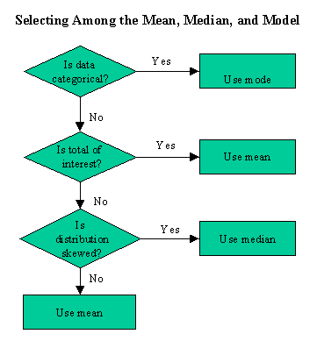

Slide 32
Shape of a Distribution
Describes how data is distributed
Symmetric or skewed
Left-Skewed
Symmetric
Right-Skewed
Mean < Median < Mode
Mean = Median = Mode
Mode < Median < Mean
(Longer tail extends to left)
(Longer tail extends to right)

Slide 33
Other Location Measures
Other Measures of Location
Percentiles
Quartiles
The p^{th} percentile in a data array:
p% are less than or equal to this value
(100 – p)% are greater than or equal to this value
(where 0 ≤ p ≤ 100)
1st quartile = 25th percentile
2nd quartile = 50th percentile
= median
3rd quartile = 75th percentile

Slide 34
Percentiles
The p^{th} percentile in an ordered array of n values is the value in i^{th} position, where
Example: The 60th percentile in an ordered array of 19 values is the value in 12th position:

Slide 35
Quartiles
Quartiles split the ranked data into 4 equal groups
25%
25%
25%
25%
Q1
Q2
Q3
Example: Find the first quartile
Sample Data in Ordered Array: 11 12 13 16 16 17 18 21 22
(n = 9)
Q1 = 25th percentile, so find the (9+1) = 2.5 position
so use the value half way between the 2nd and 3rd values,
so Q1 = 12.5
25
100

Slide 36
Measures of Variation
Variation
Range
Variance
Standard Deviation
Coefficient of Variation
Interquartile
Range
Population
Variance
Population
Standard
Deviation
Sample
Variance
Sample
Standard
Deviation

Slide 37
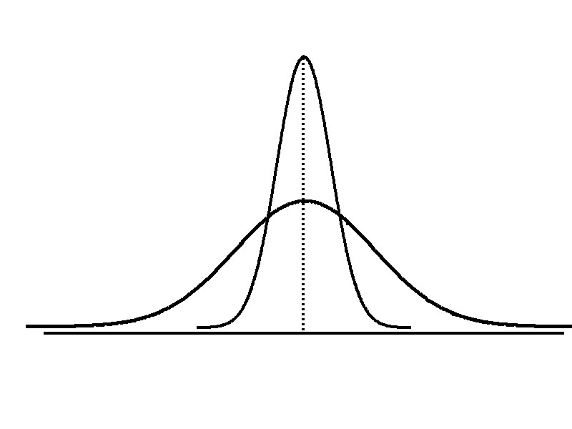
Variation
Measures of variation give information on the spread or variability of the data values.
Same center,
different variation

Slide 38
Range
Simplest measure of variation
Difference between the largest and the smallest observations:
Range = x_{maximum} – x_{minimum}
Example:
0 1 2 3 4 5 6 7 8 9 10 11 12 13 14
Range = 14 - 1 = 13

Slide 39
Disadvantages of the Range
Ignores the way in which data are distributed
Sensitive to outliers
7 8 9 10 11 12
7 8 9 10 11 12
Range = 12 - 7 = 5
Range = 12 - 7 = 5
1,1,1,1,1,1,1,1,1,1,1,2,2,2,2,2,2,2,2,3,3,3,3,4,5
Range = 5 - 1 = 4
1,1,1,1,1,1,1,1,1,1,1,2,2,2,2,2,2,2,2,3,3,3,3,4,120
Range = 120 - 1 = 119

Slide 40
Interquartile Range
Can eliminate some outlier problems by using the interquartile range
Eliminate some high-and low-valued observations and calculate the range from the remaining values.
Interquartile range = 3rd quartile – 1st quartile

Slide 41
Variance
Average of squared deviations of values from the mean
Sample variance:
Population variance:

Slide 42
Standard Deviation
Most commonly used measure of variation
Shows variation about the mean
Has the same units as the original data
Sample standard deviation:
Population standard deviation:

Slide 43
Calculation Example: Sample Standard Deviation
Sample Data (X_{i}) : 10 12 14 15 17 18 18 24
n = 8 Mean = x = 16

Slide 44
Comparing Standard Deviations
Data A
Mean = 15.5
s = 3.338
11 12 13 14 15 16 17 18 19 20 21
Data B
Mean = 15.5
s = .9258
11 12 13 14 15 16 17 18 19 20 21
Data C
Mean = 15.5
s = 4.57
11 12 13 14 15 16 17 18 19 20 21

Slide 45
Coefficient of Variation
Measures relative variation
Always in percentage (%)
Shows variation relative to mean
Is used to compare two or more sets of data measured in different units
Population Sample

Slide 46
Comparing Coefficient of Variation
Stock A:
Average price last year = $50
Standard deviation = $5
Stock B:
Average price last year = $100
Standard deviation = $5
Both stocks have the same standard deviation, but stock B is less variable relative to its price

